Slide 1
Introduction Tuesday, March 28
Notes:
Sharyn
Welcome
Introductions of speakers
Agenda for presentation (overview)
Questions in the chat (time for questions at the end, too)

Slide 2
San Diego County’s 12,000+ nonprofits
Support people of all ages, genders, identities, races, and socioeconomic groups.
Strengthen our neighborhoods.
Give voice to those served.
Have limited resources for fundraising, technology, communications, and training.
COVID-19 stressed nonprofits further.
Notes:
Sharyn

Slide 3
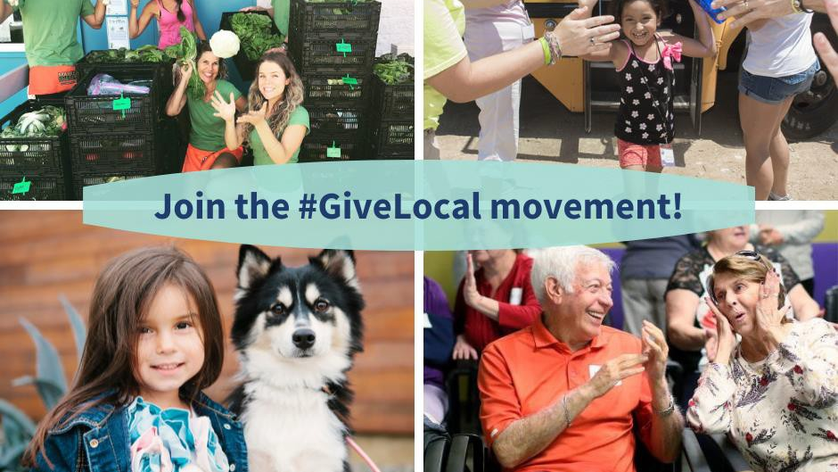
Foster a Sustainable Nonprofit Sector
Stimulate
philanthropy.
Highlight
community needs and local nonprofit responses.
Provide
learning opportunities for nonprofits and donors.
Culminate
in 48-hours of collective, online giving and volunteering.
Notes:
Sharyn

Slide 4
San Diego Gives provides nonprofits with resources needed to thrive.
Volunteers started as alternative to Giving Tuesday.
Raise awareness, connect community members, and increase financial support.
In 2021, raised $472,724 for 107 nonprofits from 2,385 donors.
In 2022, raised $1,088,647 for 327 nonprofits from 3,743 donors. Trained 533 professionals with 28 workshops. Mentored 62 nonprofits.
Notes:
Mitch
Start with San Diego Gives website overview (registration, SD Gives university, profile examples)
History

Slide 5
2023 Goals
Raise $1.5 million for 350 nonprofits.
Engage 4,000 donors, with 40% making first gifts.
Serve 600 professionals through 25 workshops.
Mentor 70 nonprofits.
Secure $75,000 for matched funds & giving day prizes.
75% of donors will express campaign satisfaction.
75% of participating nonprofits will report increased learning and positive experiences.
Day of Service Goals TBD
Notes:
Mitch
Goals of 2023 campaign

Slide 6
United Way & San Diego Gives
Day of Service – Friday, September 8th
Nonprofit Survey currently out to determine best format for volunteer projects & capacity
Onsite projects for volunteers
Central location with kit building + projects around San Diego County
Volunteer opportunities for corporate partners & community members
Notes:
Amelia

Slide 7
San Diego Gives University
Strategies for Success
Social Media Marketing
Matched Giving
Crowdfunding Tech
Donor Prospecting
Peer-to-peer Fundraising
Obtaining Sponsorships
Effective Presentations
Office Hours
Donor Retention
Mentors
Notes:
Mitch
Blurb/overview about SD Gives – set up for success, capacity building, workshops from feedback received
Two slides (1st more technical campaign support, 2nd more personal and professional development)
Where it’s posted (SD Gives university link)
Office hours overview
Mentoring for smaller organizations (included in registration form)
Relying on wisdom of the San Diego nonprofit community and supporters
CFRE

Slide 8
San Diego Gives University
Accelerating Your Nonprofit Career
Recruiting & Retention
Building Strong Teams
Board Development
Preventing Burnout
DEI Resources
Pitching to the Media
Notes:
Mitch

Slide 9
100+ Media Placements
KPBS (radio/digital) COX Media CBS8
iHeart Media KUSI-TV Giving Back Magazine
Ranch & Coast Magazine Fox 5 San Diego Business Journal
Voice of San Diego KOCT TV San Diego Union Tribune
Times of San Diego NBC There San Diego
Coast News Alpine Sun Rancho Santa Fe Review
Star News Clear Channel Billboard
Notes:
Veronica
Announce working second year with Bloom PR for a 2023 plan (adding social media to 2023 campaign).
Through San Diego Gives University Bloom PR will host specific training sessions based off cause area (more targeted media outreach).
Importance of awareness through earned and paid media.
Companies listed on the slide are from 2022.
Building on this success, finding additional media placements.

Slide 10
Social Media
Social Media Tags
@SanDiegoGives
Facebook, Twitter, LinkedIn and Instagram
Cloudcast Media Podcast
Live Local, Give Local
Weekly podcast episodes
Notes:
Veronica
Importance of social media throughout the SD Gives campaign.
Participating nonprofits will be provided with a social media toolkit.
Templates for social media (posts, banners, graphics, etc.).
Social media posts sent to sponsors and supporters.

Slide 11
Budget
Program Cost: $585,766
Public relations
Advertising
Matched funds/prizes
Training programs
Social media
Project management
Mightycause platform fees
Podcast
Supplies
Printing
Notes:
Sharyn

Slide 12
Benefits of participating
Access
Access training, mentoring, and online resources.
Raise
Raise awareness of your cause.
Gain
Gain exposure to new donors.
Energize
Energize current supporters.
Explore
Explore partnerships with participating nonprofits.
Achieve
Achieve matching donations.
Access
Access to Mighty Cause platform.
Notes:
Hannah
Go through each point in the slide and elaborate where you see fit.
Share personal experience with SD Gives through Helping Paws and Veteran Coalition.

Slide 13
Eligibility
Applications are reviewed and approved by committee. An eligible nonprofit must:
Be a 501(c)(3) public charity or have a 501(c)3 fiscal sponsor.
Demonstrate strong leadership and financial management.
Deliver quality services in response to clear need.
Funds raised serve San Diego County residents in the County.
Follow non-discrimination laws/practices.
Provide copy of 501(c)3 letter and/or financial document(s), if requested.
Contribute up to five hours to overall campaign efforts.
Spend time needed for a successful campaign, typically 1 – 3 hours/month.
Complete online profile page by July 15.
Notes:
Mitch
Run through each of the bullet points.
Contribute up to five hours to overall campaign efforts: spreading the word, mentoring, sponsorships, etc.

Slide 14
Registration
Early registration: February 1-March 31 Regular registration: April 1-30
Qualifications | Early Bird | Regular Registration
Under 2 years of operating | $25 | $50
Budget up to $1 million | $50 | $100
Budget $1 - $4 million | $100 | $150
Budget $4 - $15 million | $125 | $175
Budget over $15 million | $150 | $200
Fees help cover Mightycause platform and publicity fees.
Financial assistance available.
Notes:
Mitch
Run through each of the bullet points.

Slide 15
Project Timeline
1 Feb.
Early, discounted registration opens
Mar. 31
Early registration closes
30 Apr.
Registration closes
30 Apr.
Withdraw from campaign with full registration fee refund
14 July
Withdraw with 50% fee refund
15 July
Deadline to complete online profile
17 Aug.
Early giving opens
7 and 8 Sep.
Day of Giving and Day of Service!
Notes:
Mitch
Streamlined campaign timeline

Slide 16
Questions

Slide 17
Thank you!
Website
www.sandiegogives.org
Email
sharyn@leichtag.org
mitchell@leichtag.org
info@sandiegogives.org

